Slide 1
Natural Computing
Prof. Manish Kumar Gupta

Slide 2
Forward Error Correction for DNA Data Storage
Team Members:
Shubhangi Mehrotra (201501124)
Sajal Tiwari (201501150)

Slide 3
Why DNA Storage?
Data density 2 gram of DNA is sufficient enough to store the whole of Internet Data.
Longevity: DNA is not as easy to lose its data or get destroyed like hard disks/CDs/Pen drives etc.

Slide 4
Stages to achieve Goal
Media to byte code
Byte code to binary code
Modulation
CLustering
Error Correction
Demodulation
Binary to Byte code
Byte code to Media File Regeneration

Slide 5
Media Byte Code Binary Code
The media formats taken as inputs were text, pdf, audio, video, image etc.
The media was converted to byte code so that when converted into binary code, these bytes codes can be in chunks of 8 bits.
These bytes are converted to binary and we consider each chunk of data as 8 bits.

Slide 6
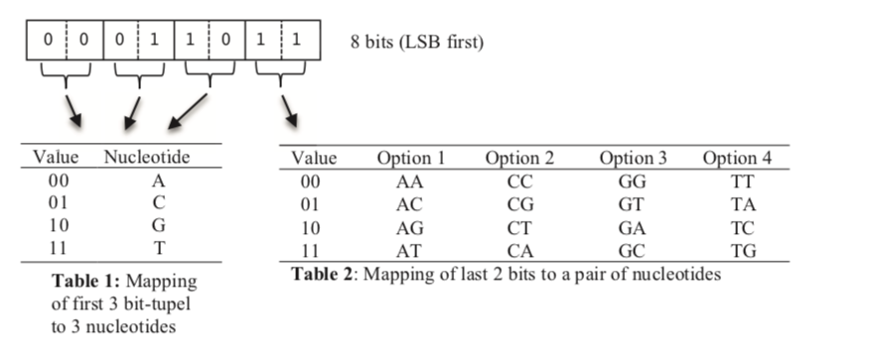
Modulation
Modulation scheme maps 8 information bit to a 5 nucleotide tuple which is known as DNA Symbols.
Eg. 00011011 will map to ACAGT, ACCGA, ACGGC, ACTGG.

Slide 7
Modulation contd.
As per the table given above we obtain a minimum of two valid strings for each 8 bits while the maximum is 4.
The conditions which need to be fulfilled by a valid string are:
i) The first three nucleotides should not be same.
ii) The last two nucleotides should not be same.
Accordingly, for the above mentioned example, ACAGT, ACCGA, ACGGC are valid mappings, while ACTGG is invalid.
Notes:
Accordingly, for the above mentioned example, ACAGT, ACCGA, ACGGC are valid mappings, while ACTGG is invalid due to two same ending nucleotides, thus violating the second constraint.

Slide 8
Clustering
There are always at least two valid DNA symbols as representation for one byte available, it is possible to group the symbols into two complete clusters A and B and one incomplete cluster C. Therefore, the data can be mapped in DNA using symbols from cluster A and B in a specific manner, e.g. alternatingly. This kind of modulation supports the detection of insertion and deletion errors.
Eg. For text “ab” binary representation would be 01100001 01100010 which would generate CGAAC CGCAG CGAAG CGCAT
CLUSTER A
CLUSTER B

Slide 9
Error Correction
Three types of error can be introduced in encoded file consisting of DNA sequence, namely, insertion , deletion and substitution.
In order to correct these errors in minimum number of moves possible Edit Distance algorithm has been used.
Sequenced nucleotide is matched with original alternating clusters and the two string are then sent to edit distance algorithm which computes minimum number of insertions/ deletions/ substitutions in order to correct the sequenced nucleotide.
Eg . If "ATGCA" is erroneous sequence and "ATAGC” is original sequence then with two substitutions erroneous sequence can be corrected.

Slide 10
Demodulation and Regeneration of File
The files are decoded with the help of reversing the algorithm used to encode them.
Demodulation converts the given DNA sequence to binary code which is then further converted to byte code , which in turn is used to recover the original file.
Eg. CGAAC CGCAG CGAAG CGCAT would be mapped back in the following way,
01100001 01100010
Binary code
Byte code
Original file
97 98
a b

